Slide 1
Cryptocurrency Sentiment Analysis
Crystal Han

Slide 2
Introduction
Cryptocurrency Market is very volatile
Use sentiment towards cryptocurrency
Client: Those interested in the Cryptocurrency market
Agenda:
Analyze Cryptocurrency sentiment
identify its relation with price
compare negative and positive values

Slide 3
Methodology
Data
Cryptocurrency API: Augmento, SentiCrypt
Already collected data from Augmento
Tools:
Python, Pandas, Numpy, SQLAlchemy
Matplotlib, Seaborn, Scikit-Learn
Github, Flask, Heroku

Slide 4
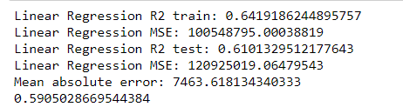
Cryptocurrency Prediction based on Sentiment Values

Slide 5
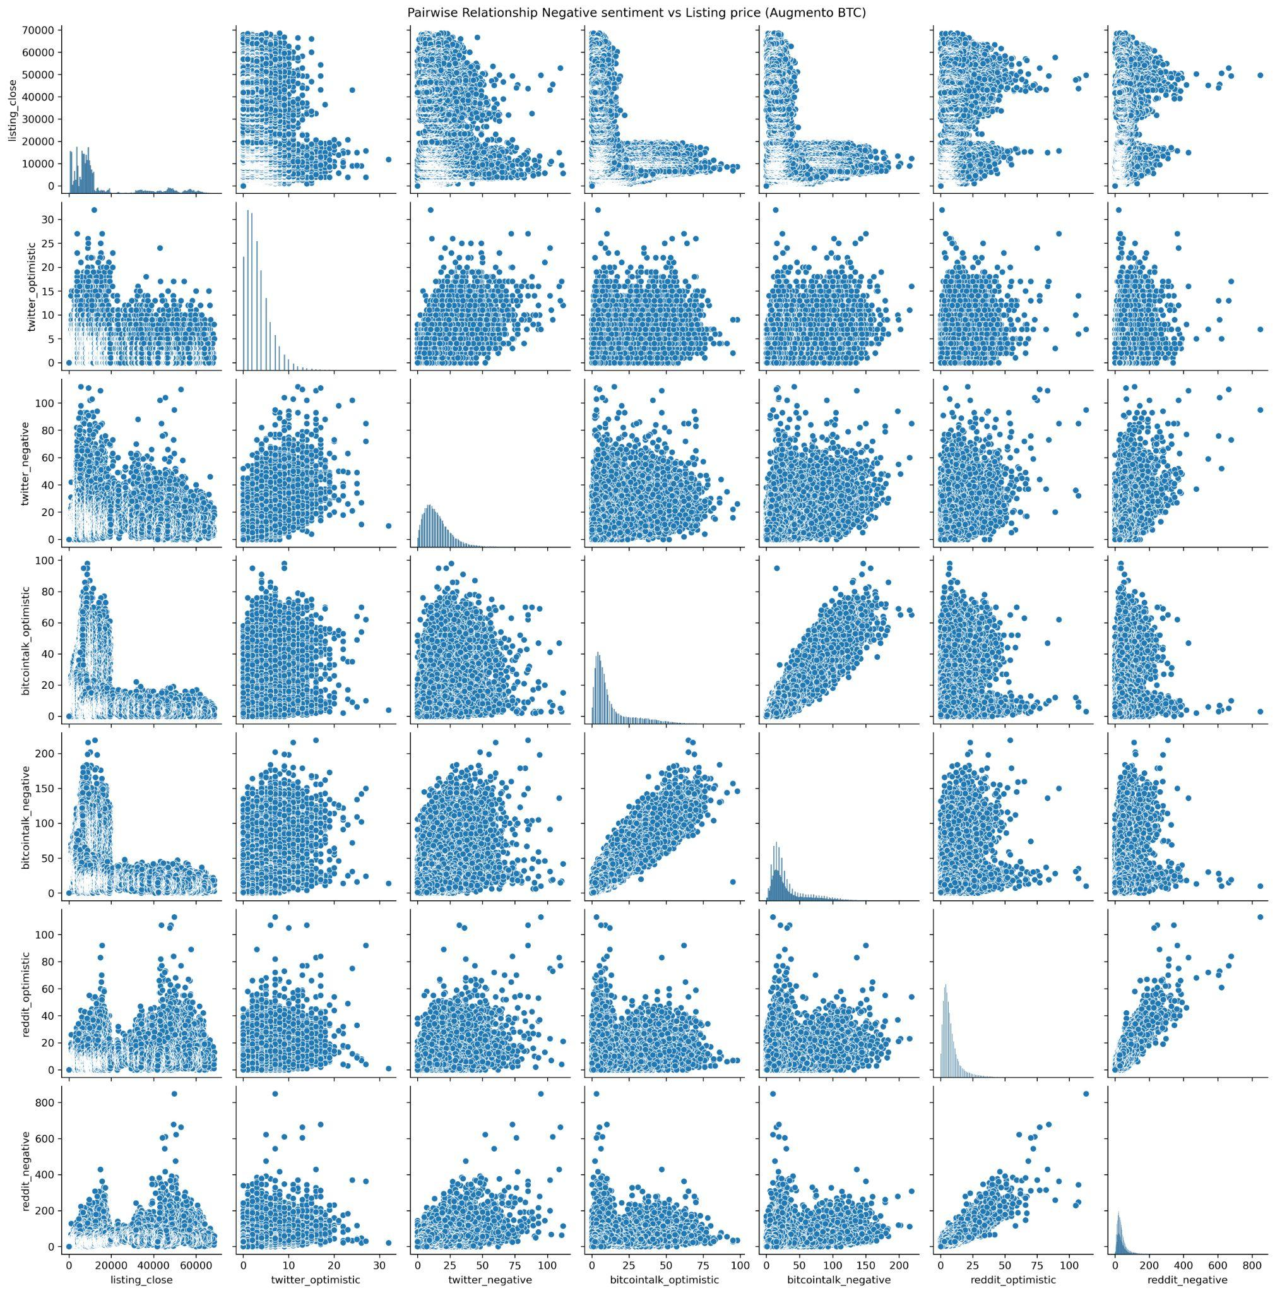
Correlation between Sentiment Values and Cryptocurrency Value (Augmento BTC)

Slide 6
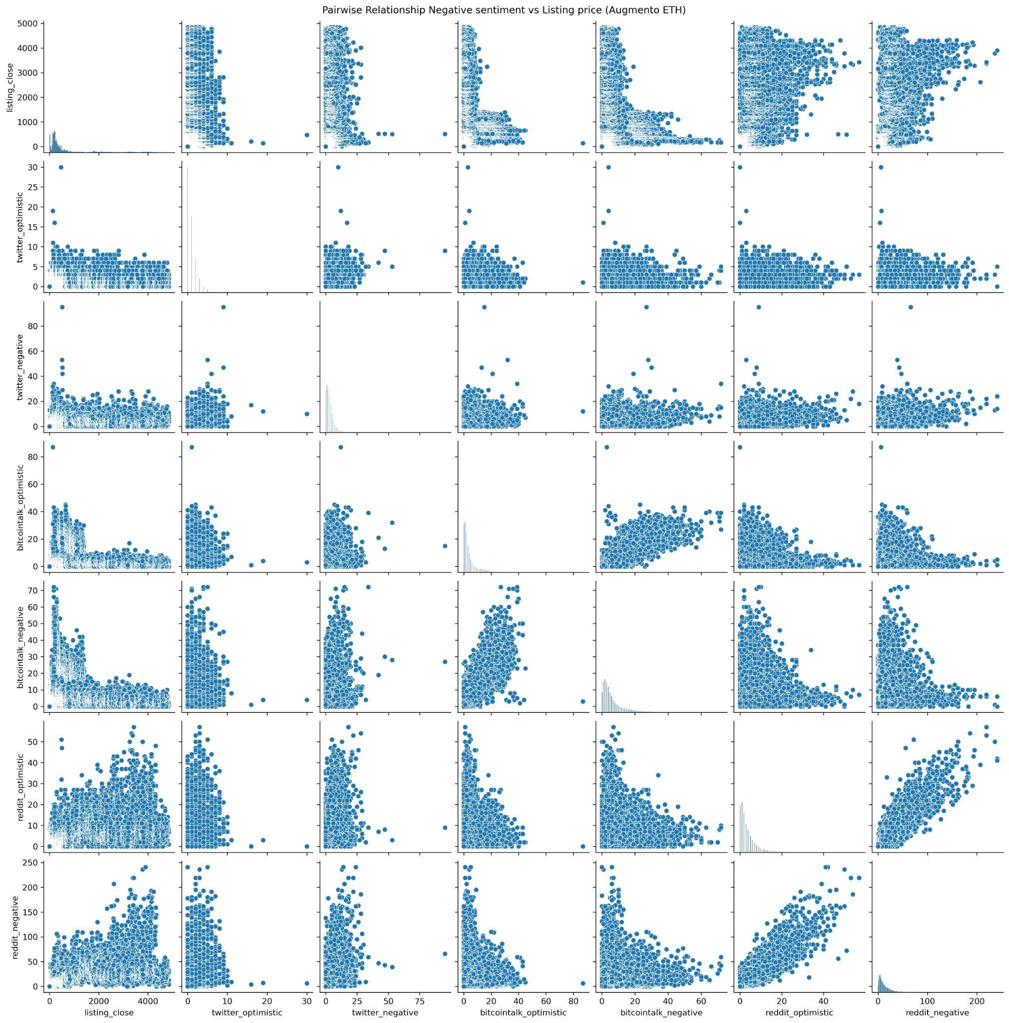
Correlation between Sentiment Values and Cryptocurrency Value (Augmento ETH)

Slide 7
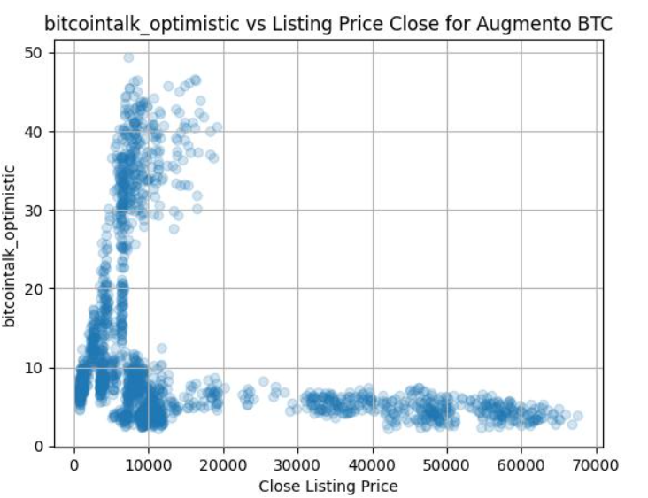
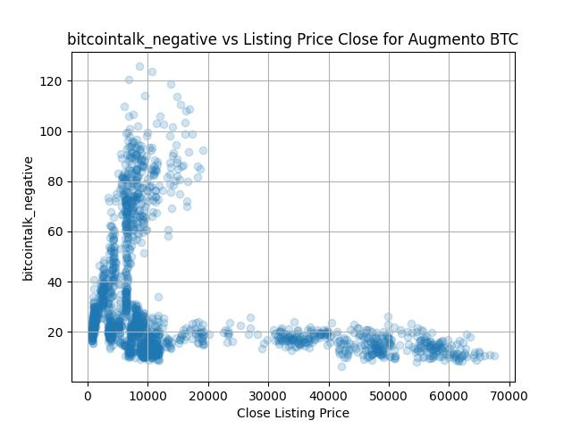
Average Daily Entries of Weekdays

Slide 8
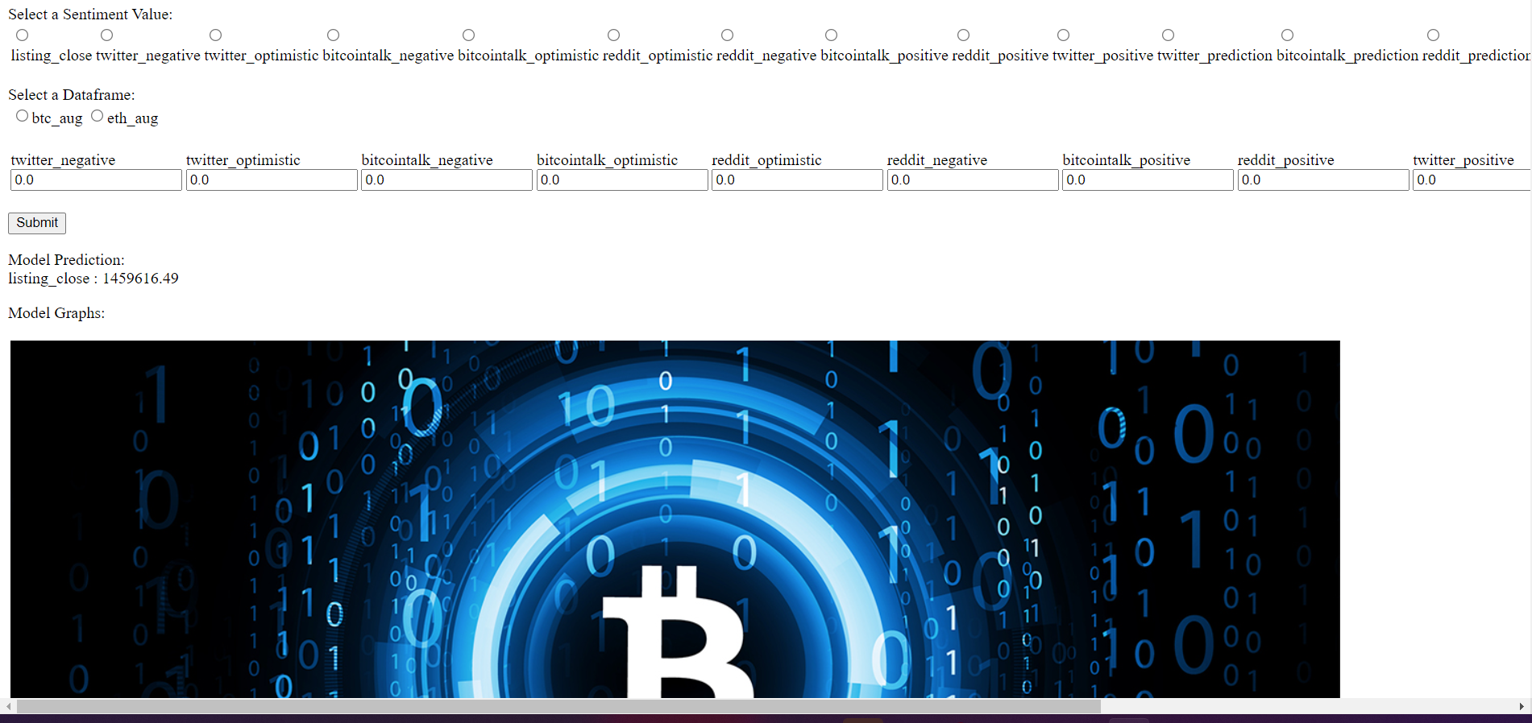
Flask Web App

Slide 9
Future Work
Make Web app prettier and adjusted to size of window
Add in different Regression
Ability for user to save the plot
Add in data analysis for Senticrypt into Flask webapp

Slide 10
Conclusion
Linear Regression Model Precision: 61%
Relation between Sentiment and Cryptocurrency Value
Engineered Model that predicts Cryptocurrency Value
Created Web app for Users to interact with

Slide 11
Appendix
APIs:
Augmento:https://www.augmento.ai/
SentiCrypt:https://senticrypt.com/docs.html
Timeframe:
Augmento: November 2016 - January 2022
SentiCrypt: January 2022

Slide 12
Thank you

